Slide 1
Image Morphology
Presented by
Nasima Islam Bithi
0421312032

Slide 2
Outline
Image Morphology
Structuring Element
Types of Morphological Operations
Differences between Operations
Matrix Representation of Operations
Flood-Fill Operation

Slide 3
Image Morphology
A set of non-linear operations that process binary images based on structuring elements or kernel which decides the nature of operation.
A structuring element influences the size and shape of objects to process in the image.

Slide 4
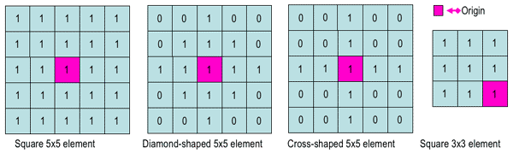
Structuring Element
A small matrix of pixels, each with a value of zero or one.

Slide 5
Types of Morphological Operations
Erosion
Dilation
Opening
Closing
Gradient
Top Hat
Black Hat

Slide 6


Erosion
A pixel in the original image (either 1 or 0) will be considered 1 only if all the pixels under the kernel is 1 (fit), otherwise, it is eroded (made to zero).
It removes pixels from object boundaries.
It removes noise or small objects so that only substantive objects remain and also detaches two connected objects etc.
Input Image
Eroded Image

Slide 7

Dilation
A pixel element is '1' if at least one pixel under the kernel is ‘1’ (hit).
It adds pixels to the object boundaries.
It makes objects more visible and fills in small holes in the object.
Input Image
Dilated Image

Slide 8


Opening
Erosion followed by dilation.
Erosion removes small objects or noise from an image while preserving the shape and size of larger objects in the image.
Input Image
Opening Image

Slide 9


Closing
Dilation followed by Erosion.
It is useful in removing noise or small holes inside the foreground object.
Input Image
Closing Image

Slide 10

Gradient
Dilated Image – Eroded Image
To find outlines of objects.
Input Image
Gradient Image

Slide 11
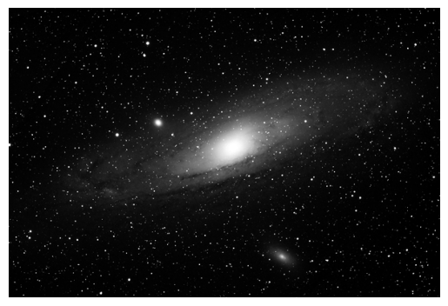
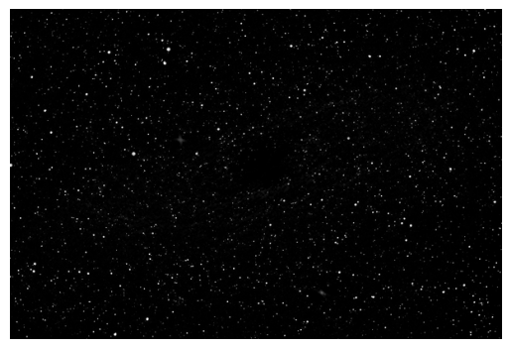
Top Hat
Input Image – opening
Highlights minor details in the image.
Input Image
Top Hat Image

Slide 12
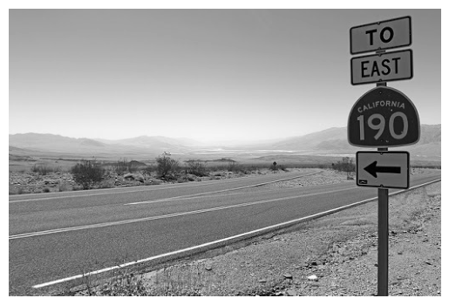
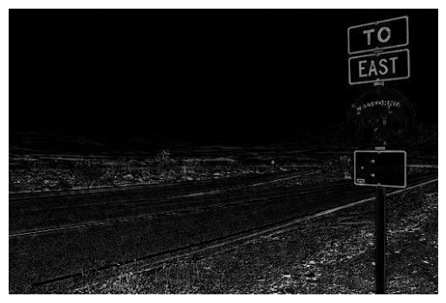
Black Hat
Closing - input image
To find bright objects in dark background.
Input Image
Black Hat Image

Slide 13
Differences between Operations
Erosion & dilation clean up the image but change the original shape of the foreground object.
In opening & closing, the shape of the foreground object remains the same as the original one.
The original image with salt and pepper noise is filtered by using morphological opening followed by closing operation.
In dilation, the binary image is assumed to have zero padding.
In erosion, the binary image is assumed to have one padding.

Slide 14
Matrix Representation of Operations
0 | 0 | 0 | 0 | 0
0 | 1 | 1 | 1 | 0
0 | 1 | 1 | 1 | 0
0 | 1 | 1 | 1 | 0
0 | 0 | 0 | 0 | 0
0 | 1 | 0
1 | 1 | 1
0 | 1 | 0
Structuring Element
Input Image
0 | 0 | 0 | 0 | 0
0 | 0 | 0 | 0 | 0
0 | 0 | 1 | 0 | 0
0 | 0 | 0 | 0 | 0
0 | 0 | 0 | 0 | 0
0 | 1 | 1 | 1 | 0
1 | 1 | 1 | 1 | 1
1 | 1 | 1 | 1 | 1
1 | 1 | 1 | 1 | 1
0 | 1 | 1 | 1 | 0
0 | 0 | 0 | 0 | 0
0 | 0 | 1 | 0 | 0
0 | 1 | 1 | 1 | 0
0 | 0 | 1 | 0 | 0
0 | 0 | 0 | 0 | 0
0 | 0 | 1 | 0 | 0
0 | 1 | 1 | 1 | 0
1 | 1 | 1 | 1 | 1
0 | 1 | 1 | 1 | 0
0 | 0 | 1 | 0 | 0
Erosion
Dilation
Opening
Closing

Slide 15
Matrix Representation of Operations
0 | 0 | 0 | 0 | 0
0 | 1 | 1 | 1 | 0
0 | 1 | 1 | 1 | 0
0 | 1 | 1 | 1 | 0
0 | 0 | 0 | 0 | 0
0 | 1 | 0
1 | 1 | 1
0 | 1 | 0
Structuring Element
Input Image
0 | 1 | 1 | 1 | 0
1 | 1 | 1 | 1 | 1
1 | 1 | 0 | 1 | 1
1 | 1 | 1 | 1 | 1
0 | 1 | 1 | 1 | 0
0 | 0 | 0 | 0 | 0
0 | 1 | 0 | 1 | 0
0 | 0 | 0 | 0 | 0
0 | 1 | 0 | 1 | 0
0 | 0 | 0 | 0 | 0
0 | 0 | 1 | 0 | 0
0 | 0 | 0 | 0 | 0
1 | 0 | 0 | 0 | 1
0 | 0 | 0 | 0 | 0
0 | 0 | 1 | 0 | 0
Gradient
Top Hat
Black Hat

Slide 16
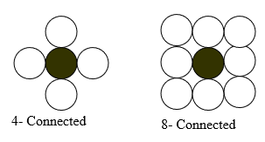

Flood-Fill Operation
It assigns a uniform pixel value to connected pixels, stopping at object boundaries. (Two ways to fill: 4-connected and 8-connected)
It takes three parameters: a start node, a target color (color of start node) and a replacement color.
4-Connected Flood Filling
8-Connected Flood Filling

Slide 17
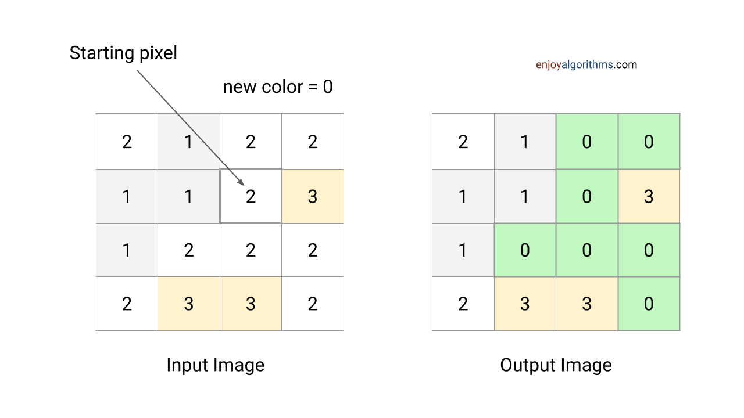
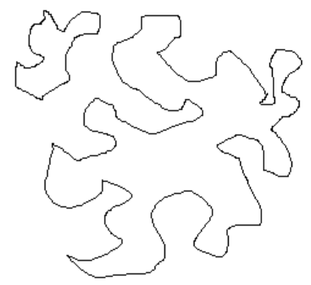
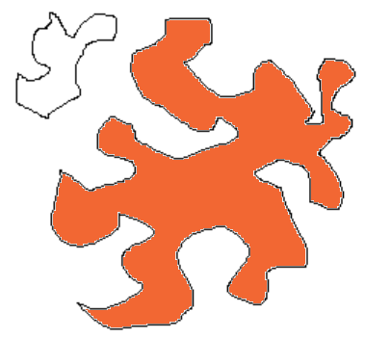
Example of Flood Filling
Input Image
Output Image
Colored with RGB(242, 103, 51)

